Slide 1




From Inquiry to Feedback:
SHAMANA Sourcing Journey
Understanding the Customer Experience Process
www.shamana-china.com

Slide 2

Thank You for Choosing SHAMANA Souricng
Thank you for choosing SHAMANA Sourcing for your business engagements in China. We are committed to delivering an exceptional customer service experience and are dedicated to supporting your business's growth and success.
With years of specialized experience, we have continuously refined our sourcing methods to better serve our clients. Our aim is to facilitate a smoother and more successful interaction with your China-related business activities, helping you avoid common pitfalls and achieve your objectives with ease.
We look forward to a fruitful collaboration and are excited to see how our partnership will help propel your business forward.
Thank you once again for your trust in SHAMANA Sourcing.

Slide 3


HOW DO WE WORK?
Our process contain 2 Parts
A. Initial Inquiry & Sourcing
B. Order Follow Up & Delivery

Slide 4

Part A. Initial Inquiry & Sourcing
Step 1: Inquiry Submission
You can start by sending us an inquiry detailing the products they are seeking.

Slide 5

Part A. Initial Inquiry & Sourcing
Step 2: Personal Introduction
One of our dedicated team members will reach out to introduce themselves and take responsibility for managing your project.

Slide 6

Part A. Initial Inquiry & Sourcing
Step 3: Supplier Selection
We commence the search for real suppliers using a method refined from years of experience.
We focus exclusively on factories, thoroughly verify supplier information, and select only stable suppliers who meet our stringent criteria.
This ensures that we connect you with the most reliable supplier possible.

Slide 7

Part A. Initial Inquiry & Sourcing
Step 4: Quotation and Payment
Once sourcing is complete, we provide you with the most suitable quotation.
If you accept our quotation, rest assured there are no additional fees or hidden costs.
We will issue an invoice, and upon payment, we proceed with order processing.

Slide 8
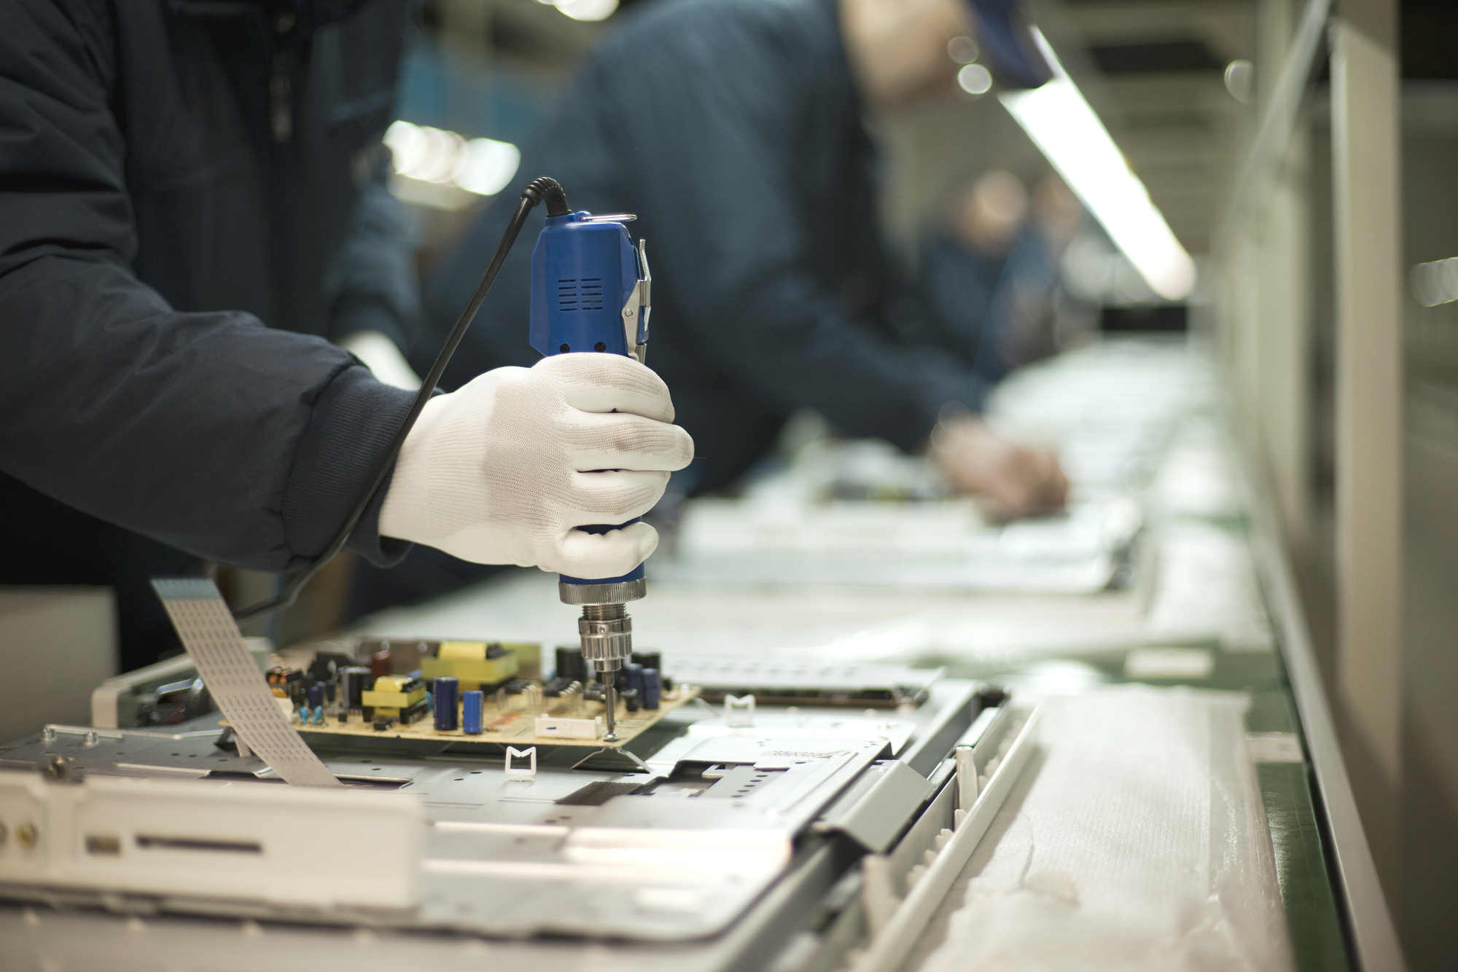
Part B.Order Processing and Delivery
Process 1: Production Monitoring
Throughout the production process, we regularly check on the supplier to ensure there are no issues or delays.
Our team actively manages the production timeline to maintain adherence to the delivery schedule.

Slide 9
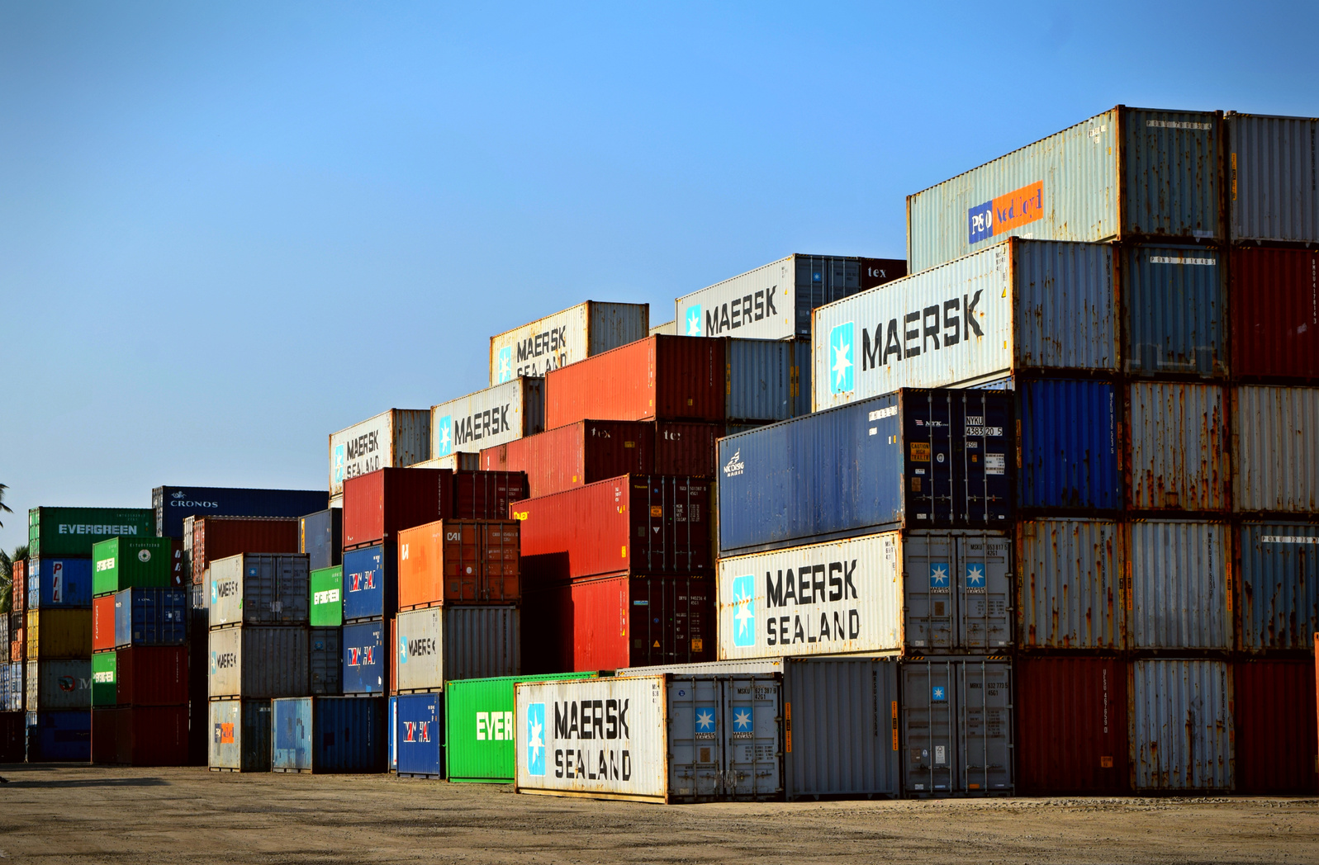
Part B.Order Processing and Delivery
Process 2: Shipping Coordination
Before production concludes and the products are ready to ship, we will contact you to finalize the shipping method and agree on the conditions.
Please refer to the INCOTERMS conditions listed on your invoice.
Once agreed upon, we have all the necessary details to ensure a successful delivery.

Slide 10
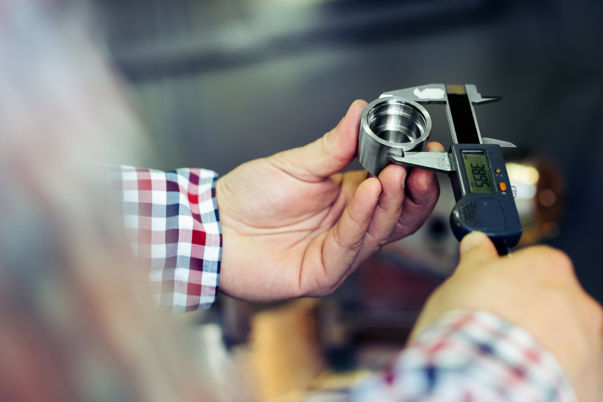
Part B.Order Processing and Delivery
Process 3: Quality Inspection
Depending on the specifics of your order, we typically conduct a thorough inspection of the products.
In some cases, you will receive a detailed inspection report. If the products meet our quality standards, we proceed with loading and prepare them for shipment.
Full payment of the invoice is required at this point to proceed with loading.

Slide 11

Part B.Order Processing and Delivery
Process 4: Feedback and Follow-Up
After you receive your products, we eagerly await your valued feedback.
Your satisfaction is crucial to us, and we look forward to serving your future needs.

Slide 12
What do we need?
  Your Company details
  Your contact details
  Information on the product we are searching
Thank you for your Business

